Slide 1
Mobile Programming
Android Programming
Chap 5. Widget & Event 2
Prof. Joohyung Lee
Email) j17.lee@gachon.ac.kr

Slide 2
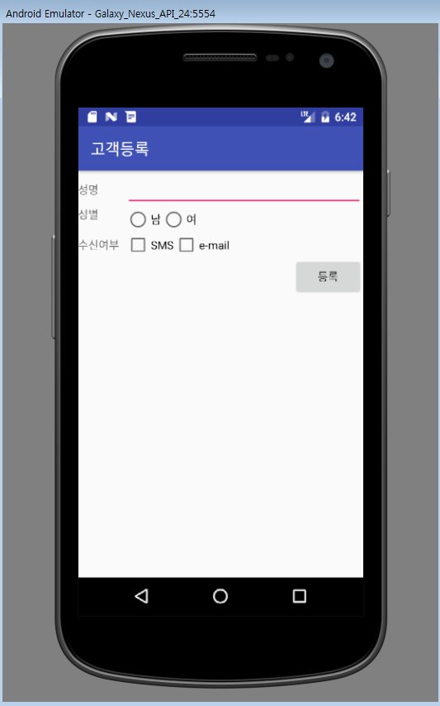
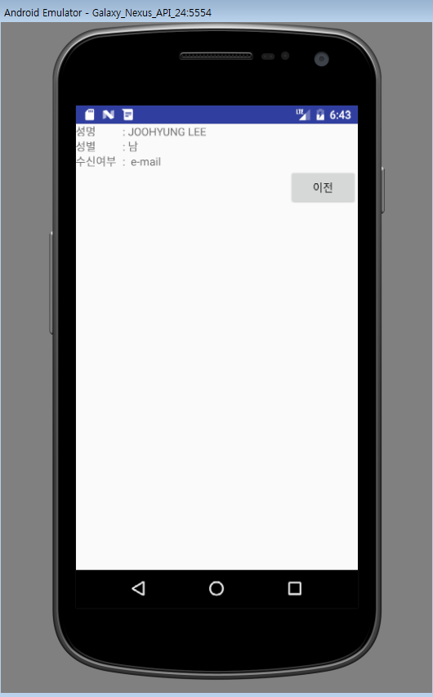
LAB IV – Do it yourself!!
Making an app for “고객등록”, which include Edit Text, Radio Button & CheckBOXJ
click
Enter input value & click

Slide 3
LAB IV – Hint
Two Activities (MainActivity & RegisterActivity)
  Need to register new activity in manifest file
This LAB helps you to use intent/checkbox/radio button/edittext at the same time
<activity android:name=".RegisterActivity">
</activity>

